Slide 1
How Annual members and Casual riders use Cyclistic bikes differently?
Presented by: Naveeth Reddy Chitti
Last Updated on: 18.04.2022

Slide 2
Agenda
Business Objective
Data
Analysis
Recommendations

Slide 3
Business objective
To analyze how annual members and casual riders use Cyclistic bikes differently and recommend best marketing strategies to convert casual riders to annual members.

Slide 4
Data
For the purpose of analysis, we use Cyclistic bike share company’s data
12 Months data from April-2021 to March-2022[1]
The data has been made available by Motivate International Inc.
[1] https://divvy-tripdata.s3.amazonaws.com/index.html

Slide 5
Analysis
Comparing Members and casual riders based on
Number of rides
Average ride lengths
Bike types
Popular trips

Slide 6
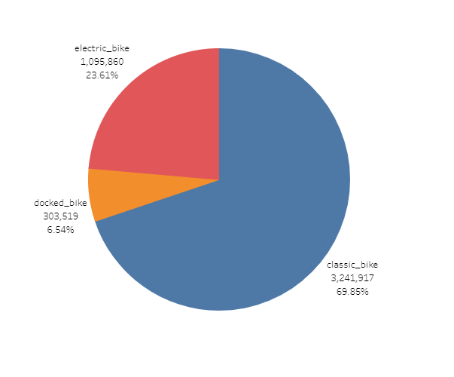
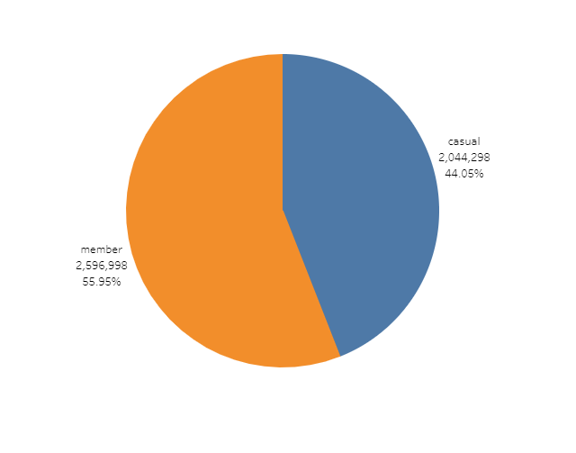
Analysis
Overall No. of rides No., of rides by each bike type
Annual members take more number of rides ; Classic bike is the most used bike type

Slide 7
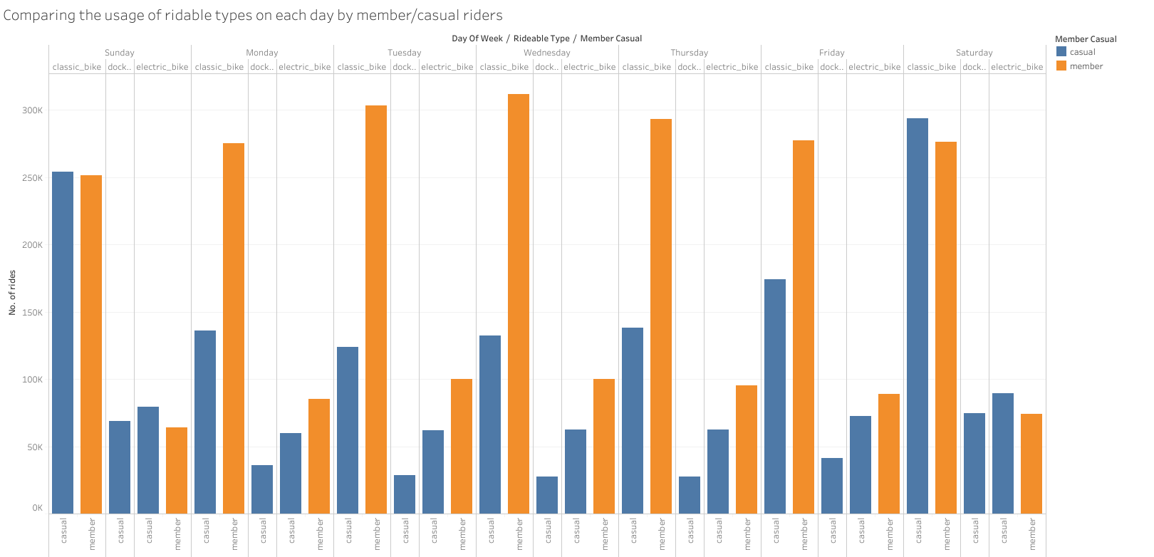
Comparing based on rideable type(Bike type)
Takeaway:
Classic bikes are most used and docked type are least used

Slide 8
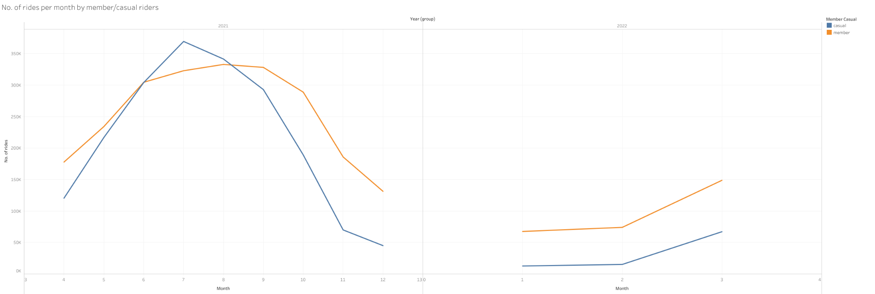
Month wise comparison: April-2021 to March-2022
In July and August Casual members took more no. of rides

Slide 9
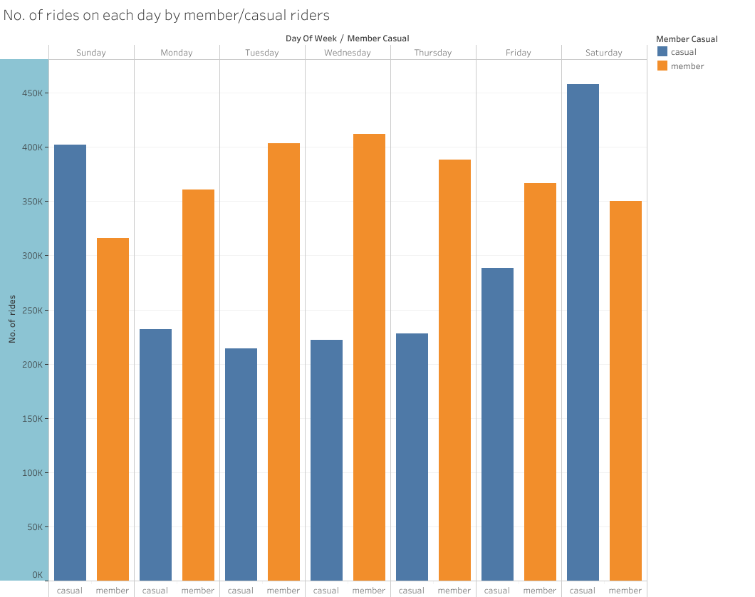
Day wise comparison: No. of rides
Takeaway:
Casual riders take more trips on weekends whereas, Annual members make more trips in mid week days

Slide 10
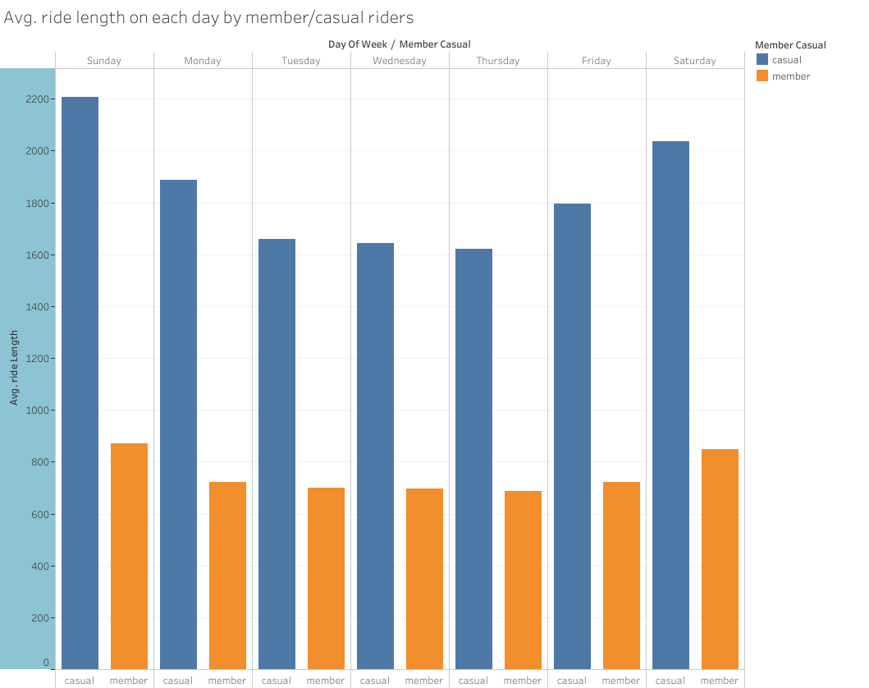
Day wise comparison: Avg ride length
Takeaway:
Casual riders take longer rides than members.

Slide 11
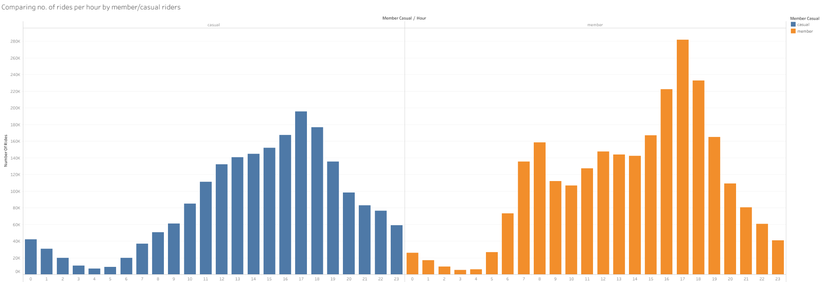
Comparison by hour: No. of rides
Takeaway: peak hours for both members and casual riders are 16:00 to 18:00

Slide 12
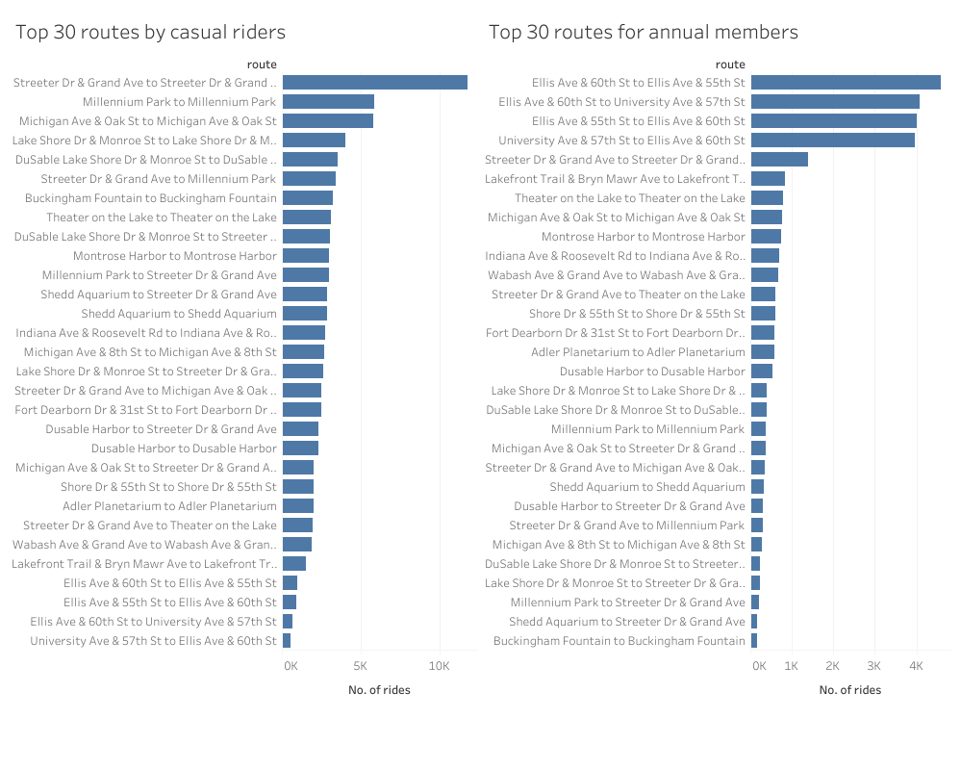
Top 30 routes of members and casual riders

Slide 13
Recommendations
Target most popular stations for casual riders to run marketing campaigns.
Casual riders use bikes mostly on weekend days, whereas, members use mostly on weak days. Hence, purpose of the ride would help in further analysis (Consider conducting a survey).
Peak hours for both rider types are similar; target those hours.

Slide 14
Limitations and Next steps
Limitations:
Many NA values
Inconsistent station id’s and ride id’s
Missing information about rider, purpose of ride.
Next steps:
Collect the data for more number of years.
Gather more information about rider so that we can analyze who prefers which type of bike.
Conduct a survey about purpose, distance from their location to the station, reason for membership(if member)

Slide 15
Thank you
Questions?

